Slide 1
Title Slide
Title: Aviation Safety Risk Analysis for Investment Subtitle: Insights from NTSB Aviation Accident Data Presenter: Nicole Kagendo Chabari Date: [29th June 2025]

Slide 2
THE PROJECT OVERVIEW
Why We Did This Analysis:
Our company is exploring investments in the aviation industry, targeting both private and commercial aircraft.
Since we have no experience in aviation, we need to understand safety risks.
This project investigates historical accident data to identify safer aircraft types for investment.

Slide 3
THE BUSINESS UNDERSTANDING
The business needs to know:
Which types of aircraft have higher or lower accident rates?
Which parts of a flight carry the most risk?
Are certain aircraft models cause more accidents?
Is the aviation getting safer over time?

Slide 4
THE DATA UNDERSTANDING
Source: U.S. National Transportation Safety Board (NTSB)
Records: Aviation accidents from 1962 to 2023
Key columns: Aircraft category, phase of flight, aircraft model, accident date, injuries
Over 90,000 records analyzed

Slide 5
Data Analysis Methods
How We Analyzed the Data:
Python with pandas: for loading and cleaning the data
Seaborn and matplotlib: for creating visualizations
Data cleaning: Removed incomplete or irrelevant fields
Grouping and counting: Used to summarize risk by flight phase and aircraft model

Slide 6
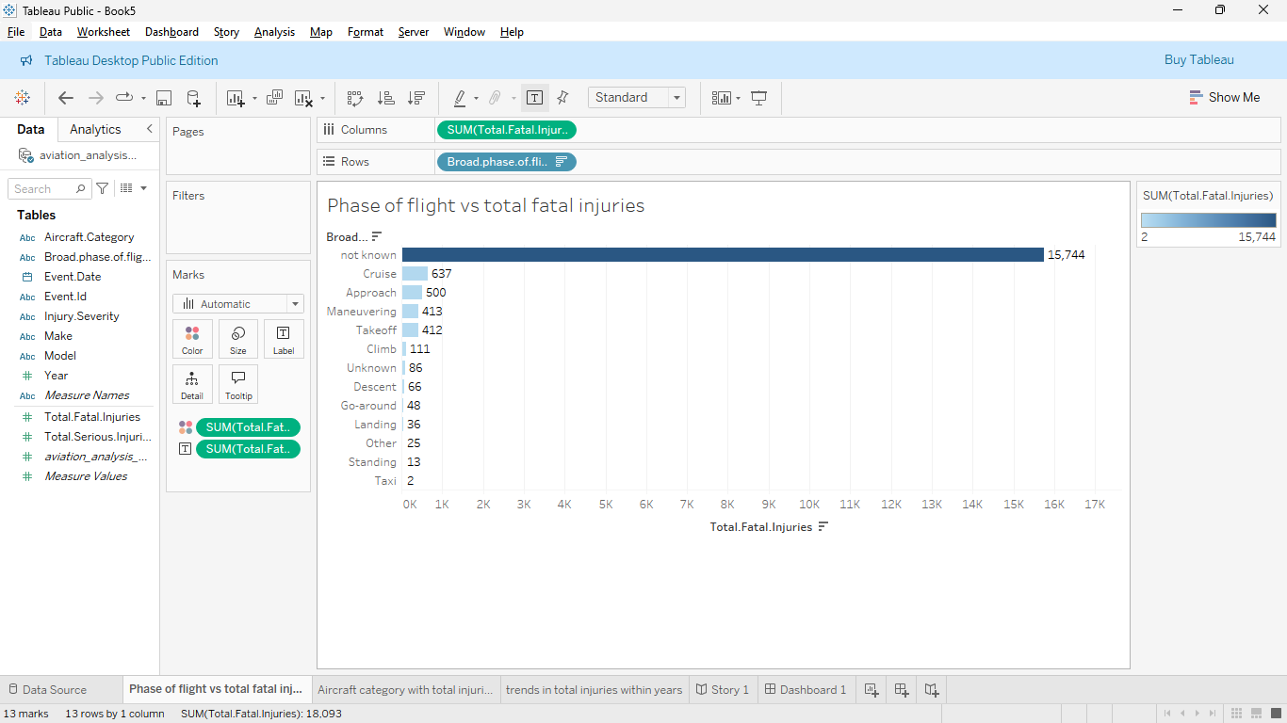
When Accidents Happened Most
Visualization: Accidents by Phase of Flight (bar chart) Insight:
Most accidents occur during landing, takeoff, and approach.
These phases are more complex and require greater pilot control. Business Takeaway: Invest in pilot training and equipment focused on safer landings and takeoffs.

Slide 7
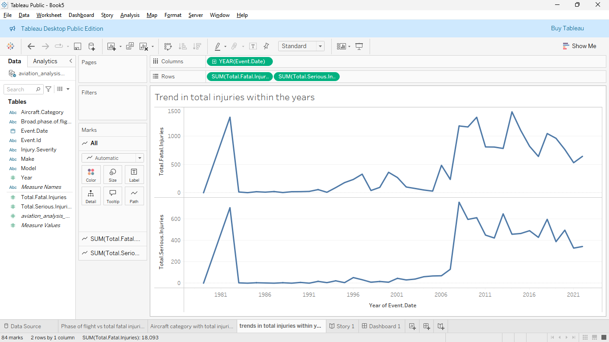
TREND IN TOTAL INJURIES OVER THE YEAR
There was a higher number of injuries in earlier years, especially between the 1970s and early 1990s.
From the late 1990s onward, the trend shows a steady decline in total injuries.
This drop suggests improved aviation safety, including better aircraft design, stricter regulations, and enhanced pilot training.
Recent years have fewer injuries overall, even

Slide 8
Are Things Getting Better?
The number of accidents has decreased significantly over time.
Newer aircraft and improved safety regulations have made flying safer. Business Takeaway: Focus on modern aircraft models and post-2000 safety records.

Slide 9
Summary of Recommendations
Prioritize safety in landing and takeoff – the riskiest phases
Select common, proven aircraft models with good safety support
Invest in newer aircraft with better technology and recent safety improvements

Slide 10
NEXT STEPS
Shortlist potential aircraft based on model reliability and recent performance
Engage with aviation safety consultants for technical validation
Begin market analysis for leasing, private hire, or cargo operation feasibility

Slide 11
THANKYOU
Slide Title: Questions & Contact Thank you for your time. I welcome any questions or feedback.
Presenter: Nicole Chabari

Slide 13
)

